Slide 1

INCLUDING LOCATION AND SCALE INFORMATION REDUCES FALSE POSITIVE INFERENCE WITH ALDEX2 WHEN ANALYZING HTS DATASETS
Michelle Nixon Pistner°, Justin Silverman
and Greg Gloor*
° Penn State and * U. Western Ontario
ggloor@uwo.ca : @gbgloor

Slide 2

The goal
Given a metatranscriptome dataset:
Identify functional differences
Ideally housekeeping genes are not significant
Using ALDEx2 to build a Bayesian model of location and scale
Notes:
Many more fragments than we can count

Slide 3
ALDEx2 builds a posterior model of the data via Monte-Carlo Sampling from a multinomial Dirichlet followed by a log-ratio transformation
We can move the location
(Difference axis)
We can add scale uncertainty
(Dispersion axis)
0
0
Notes:
Many more fragments than we can count

Slide 4
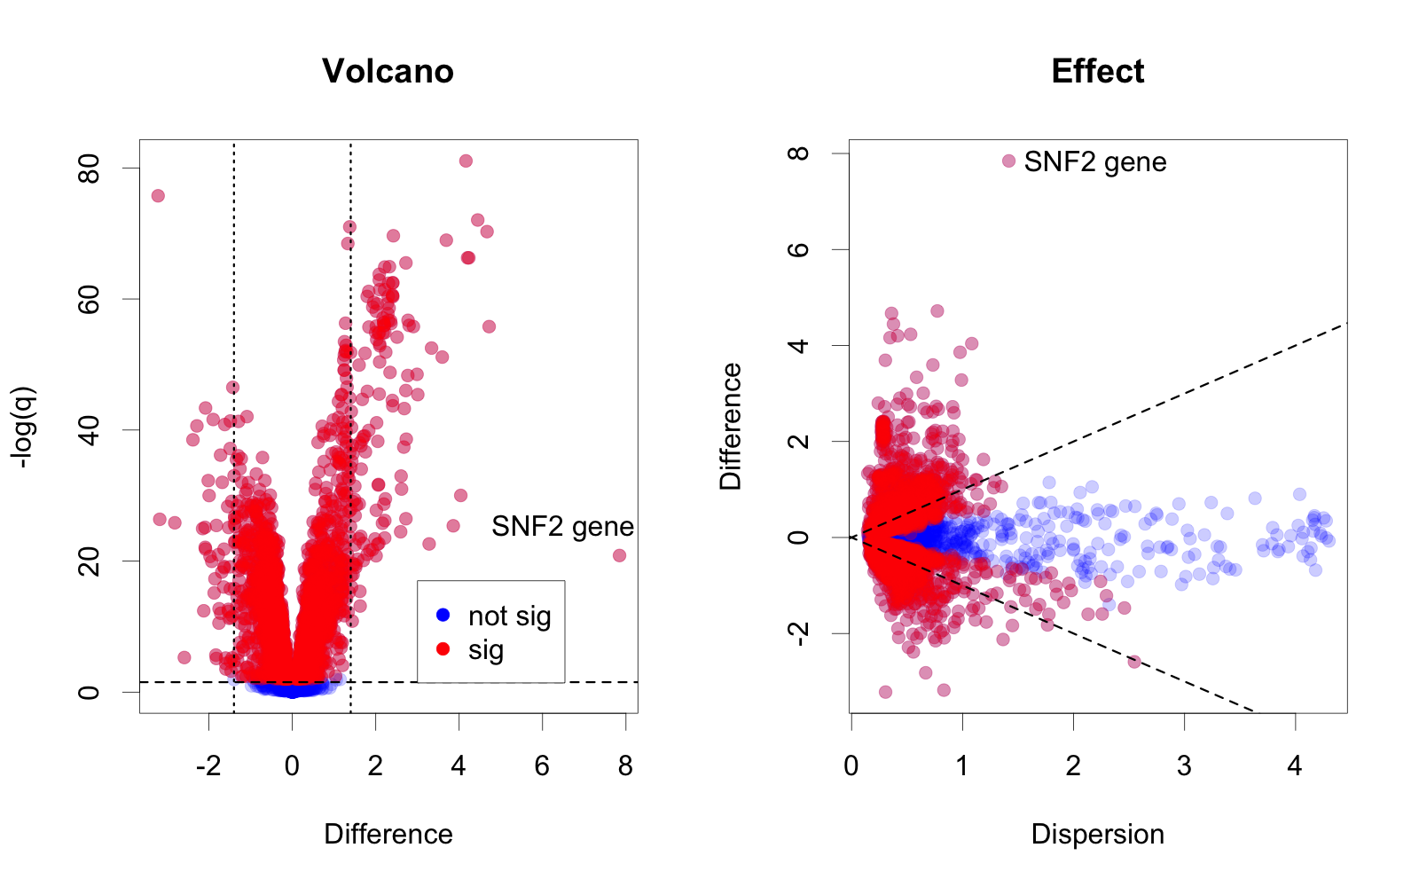
Overpowered analyses in HTS
Yeast transcriptome: 63% of genes are ‘significant’
Schurch (2016) RNA 22:839
Notes:
Many more fragments than we can count

Slide 5
Overpowered analyses in HTS
LOCATION
LOCATION
SCALE
Yeast transcriptome: 63% of genes are ‘significant’
Schurch (2016) RNA 22:839
Notes:
Many more fragments than we can count

Slide 6
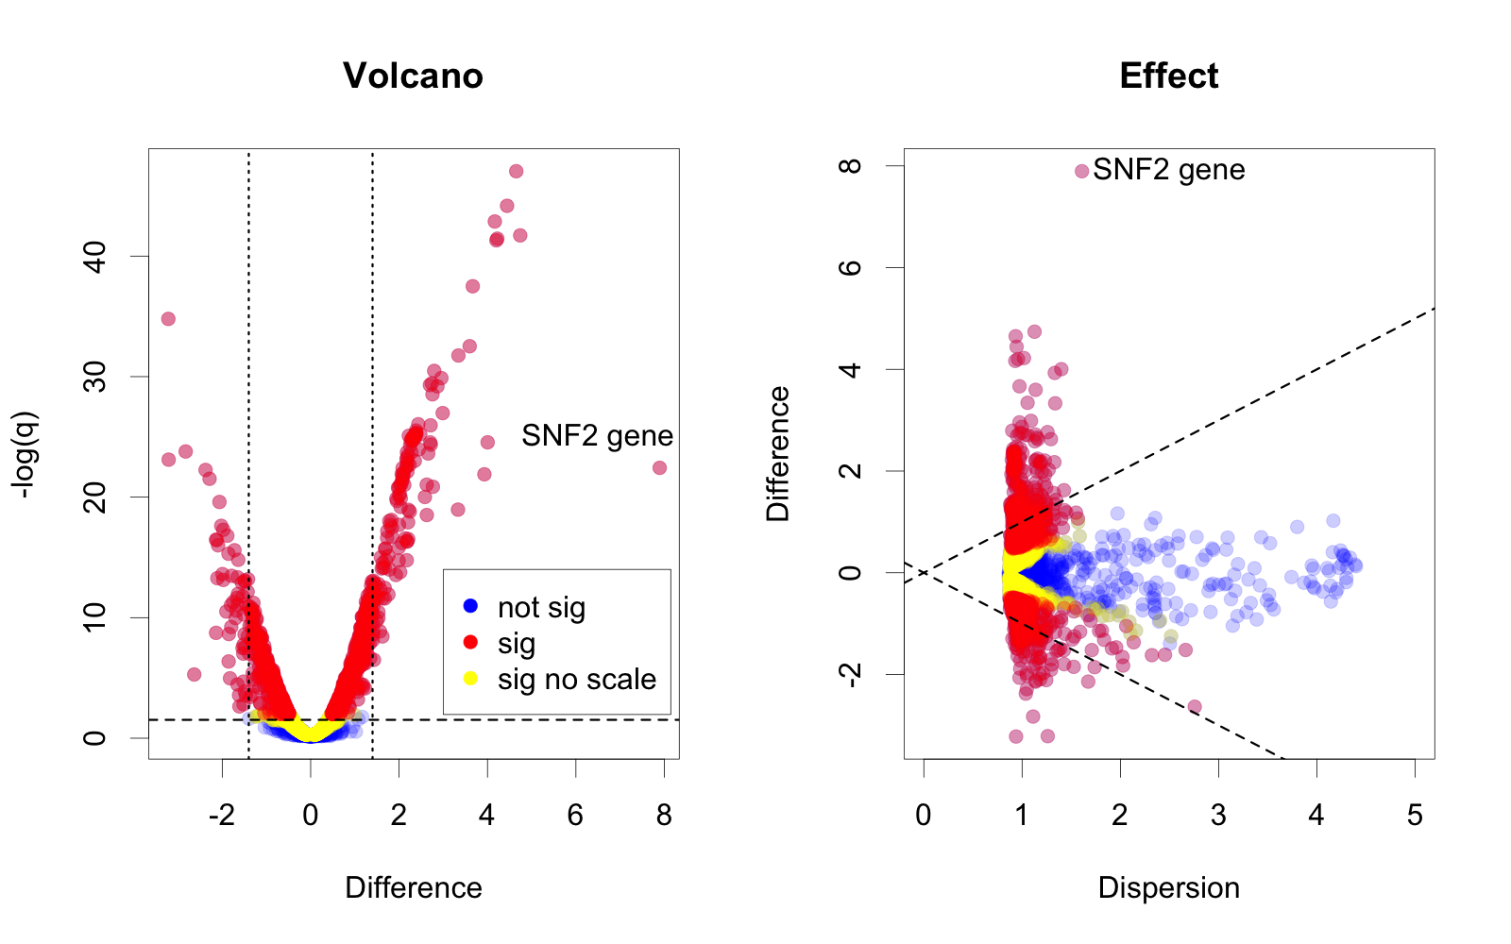
Overpowered analyses in HTS
Scaling adds noise to the dispersion: only 20% of genes significant (gamma=0.2)
Schurch (2016) RNA 22:839
Notes:
Many more fragments than we can count

Slide 7
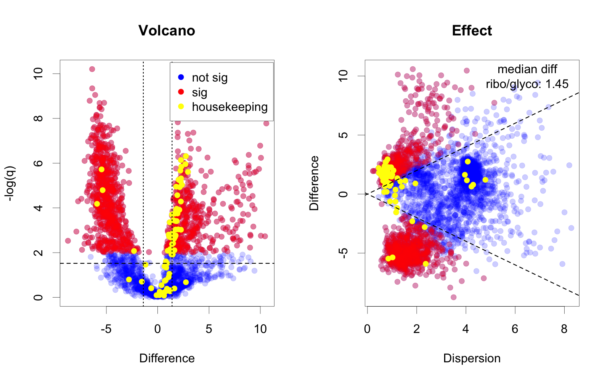
Vaginal Meta-transcriptomics
Unscaled, housekeeping genes are different because there is 100X difference in the underlying scale
Notes:
Many more fragments than we can count

Slide 8
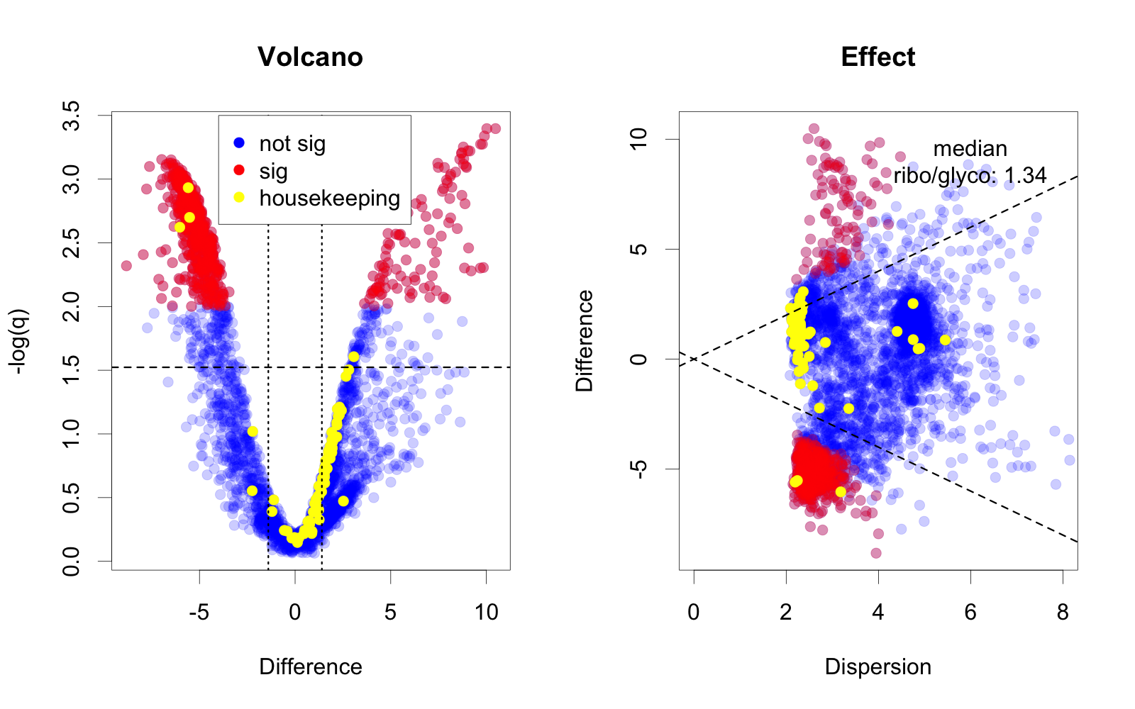
Vaginal Meta-transcriptomics
Scaled, housekeeping genes are not different because we have added scale uncertainty (gamma=0.5)
Pistner-Nixon (2023) https://arxiv.org/pdf/2201.03616.pdf
Notes:
Many more fragments than we can count

Slide 9
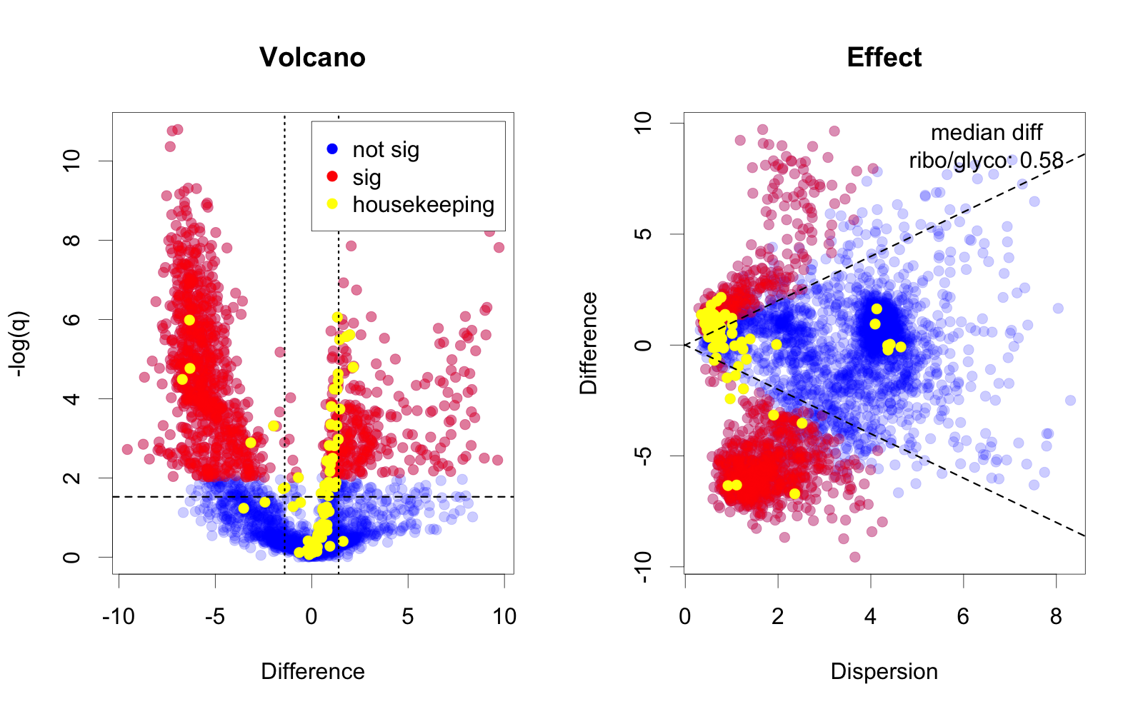
Vaginal Meta-transcriptomics
Centered, housekeeping genes are not different because we have moved the location (denom=‘lvha’)
Wu (2021) Adv. Comp. Data. Anal (Springer)
Notes:
Many more fragments than we can count

Slide 10
Summary
ALDEx2 builds a posterior model of the data through Monte-Carlo Sampling from a multinomial Dirichlet followed by a log-ratio transformation (Fernandes (2014) Microbiome 2:15)
We can move the location (Difference)
We can add scale uncertainty (Dispersion)
Scaling and centering will be available in the next Bioconductor update
Scaling:
aldex.clr(data, conds, gamma=value)
Centering:
aldex.clr(data, conds, denom=‘lvha’)

